Slide 1
Academic Integrity

Slide 2
What is academic integrity?
Talk with your neighbours and produce a definition.

Slide 3
What is academic integrity?
It is both a value and a set of skills that relates to the completion of academic work in an honest, respectful, and responsible manner.
Do your own work and acknowledge the work of others.

Slide 4
Why is academic integrity important?
Talk with your neighbours and produce some ideas.

Slide 5
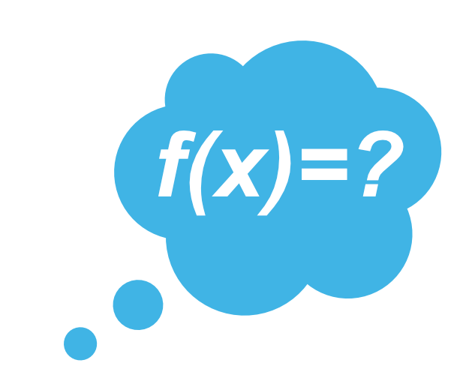
Your learning will be more effective!
It is important for your future career goals and reputation!
Why should you learn with integrity?
It is expected of everyone within the UBC community!

Slide 6
How do you
learn with integrity in this class?
Talk with your neighbours and generate some ideas.

Slide 7
How do you learn with integrity?
Understand and follow the course guidelines.
Check the syllabus and ask the instructor if you have questions.
Only use acceptable resources for all assessments.
Acknowledge the work of others.

Slide 8
What is
academic
misconduct?
Cheating
Plagiarism
Falsification
Gaining or attempting to gain an unfair academic advantage or benefit.
Impersonation
Self-plagiarism
Contract cheating

Slide 9
Can you use
generative artificial intelligence tools?
Depending on the class, these tools may be permitted for certain types of academic work.
Always check with your instructor before using any form of generative AI.

Slide 10
Want to learn more?
academicintegrity.ubc.ca

